Slide 1


Alpha Phi Omega
Chi Chapter at UCLA
Alpha Lambda / Yuna Choi Term, Meeting 4
April 16, 2014
www.apo-x.org

Slide 2
Agenda
1. Chapter Business
2. Officer Updates and Announcements
3. Last Announcements

Slide 3
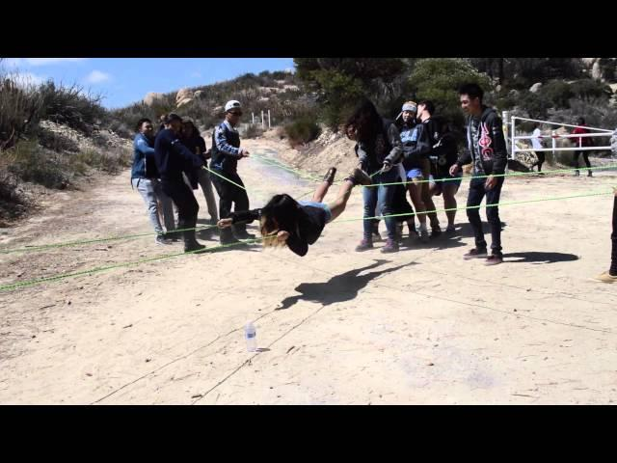
Webisode #3

Slide 4
President
Jessica Suhardjo
president@apo-x.org
Executive Committee
excomm@apo-x.org

Slide 5
Leadership Workshops
More Leadership Workshops!
- April 28, Constitution Day
- May 4, Excomm 411
- Meet the Excomm?

Slide 6
Gamer’s Guide Tip #4
The Secret To Pixar’s Success: Failure
In an interview with BuzzFeed, Pixar co-founder Ed Catmull discusses his new book, Creativity Inc., and says reframing the concept of failure is the only sure way to find success.
Notes:
“While the process was difficult and time-consuming, Pete and his crew never believed that a failed approach meant that they had failed, Instead, they saw that each idea led them a bit closer to finding the better option.

Slide 7
Gamer’s Guide Tip #4
“I often say that [you] must hold lightly to goals and firmly to intentions. At Pixar, we are willing to adjust our goals as we learn, striving to get it right, not necessarily to get it right the first time. Because that, to my mind, is the only way to establish something else that is essential to creativity: a culture that protects the new.”
Notes:
So this tip is pretty relevant to your daily lives in terms of failures and success but specifically in terms of apo and our chapter, this tip is really a segue for me to start talking to you about our midchapter evaluations. For pledges that don’t know what Forum is, its a time where we take a step back as a chapter and really try to address any issues that we see with how we’re doing things and try to fix them in the remaining time of the term or for future reference in terms to come. Before we start I just want to let you guys know that this term we tried doing a lot of new things. In doing so, we changed lots of things that may or may not have been successful, but I want to remind you guys that failure of a new program or new idea does not equate failure in a specific excomm member, failure in our active body, or failure in our chapter as a whole. It simply means that we figured out what doesn’t work, and can move on from that to continue and find what does. So we’re going to go ahead and start forum right now, pledges will have their separate forums and pledge parents will instruct you on what to do. Everyone else move to the front of the room and lets get started!

Slide 8
Chapter Business

Slide 9
Midchapter Evals Discussion

Slide 10
Historian
Tin Tran
historian@apo-x.org

Slide 11
Music Video

Slide 12
:(
There will be no online picture submissions

Slide 13

Alpha Lambda Termbook
No progress :(
What to expect :
Revelations
Campout

Slide 14

Brothers of Chi Chapter
Change of plans!
Submit pictures to Historian and
and let the Chapter decide
which caption is best!
apoxhistorian@gmail.com
(925)-231-5359

Slide 15
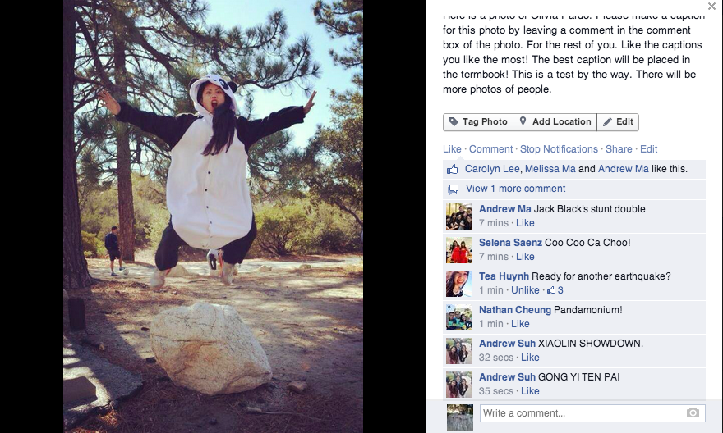
Brothers of Chi Chapter

Slide 16
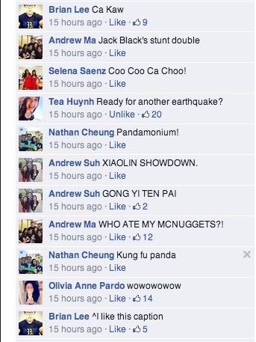
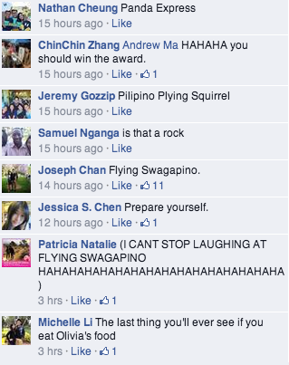
Brothers of Chi Chapter

Slide 17
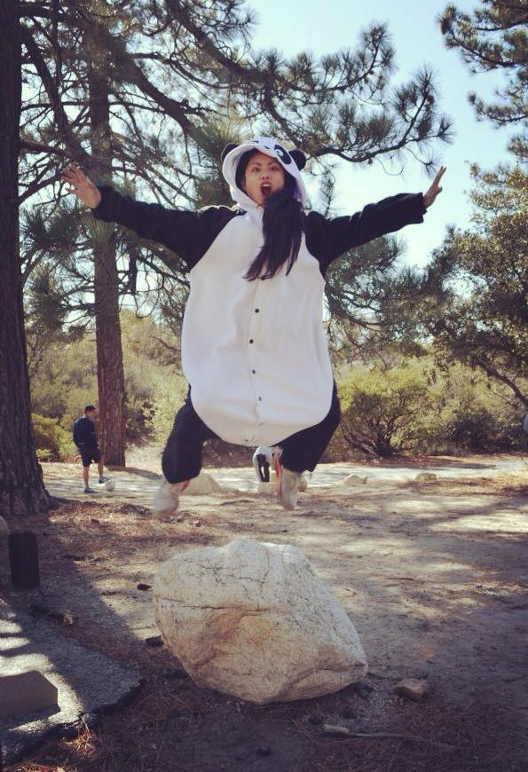
Brothers of Chi Chapter
”Ready for another earthquake?”
Submitted by Kristine Huynh

Slide 18
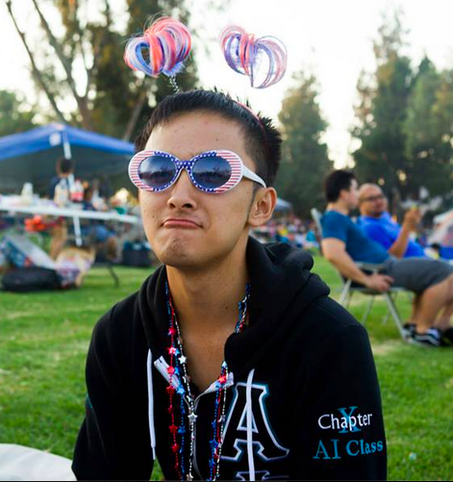
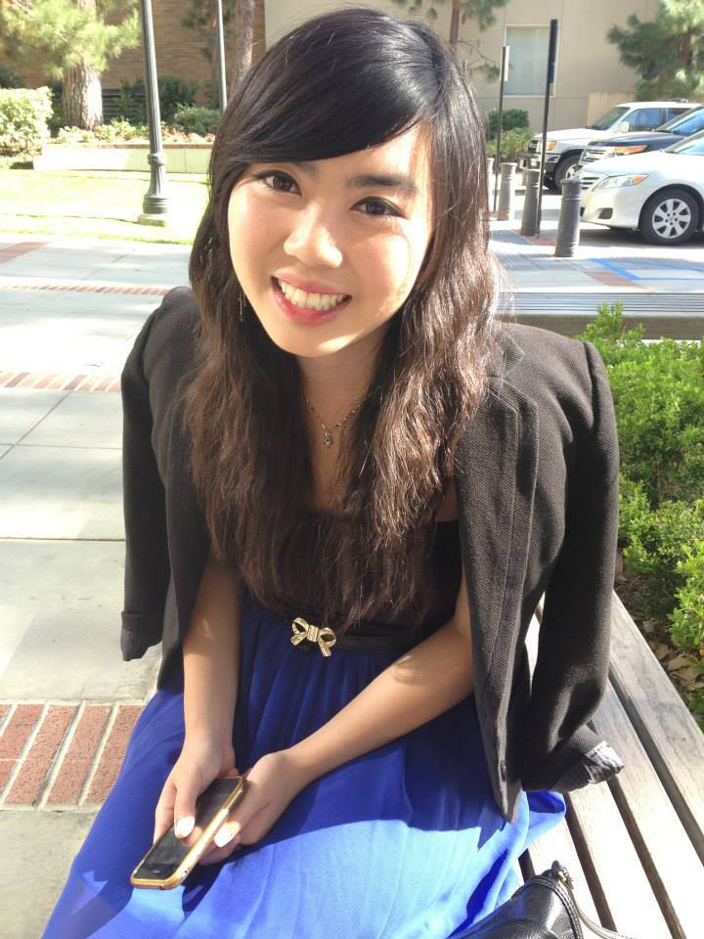
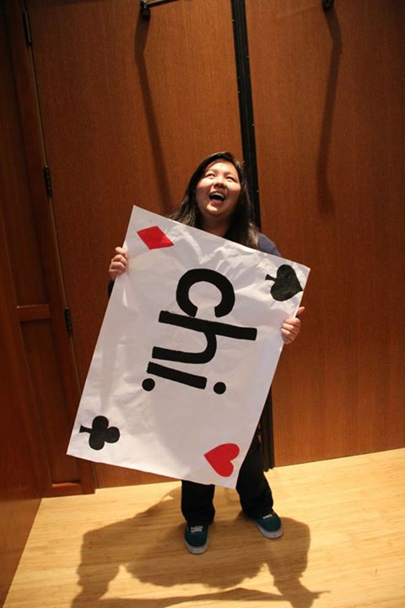
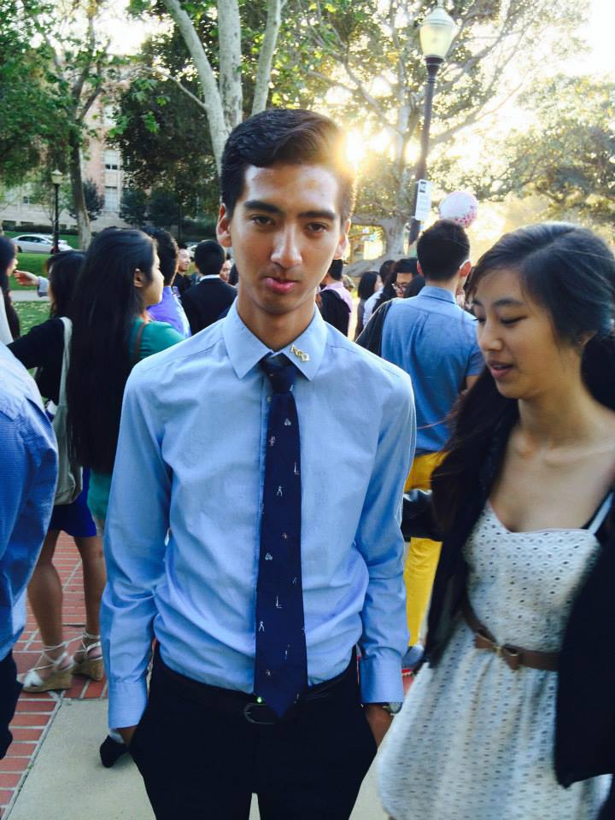
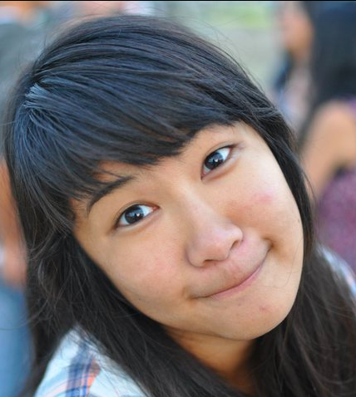
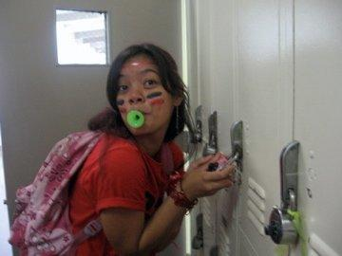
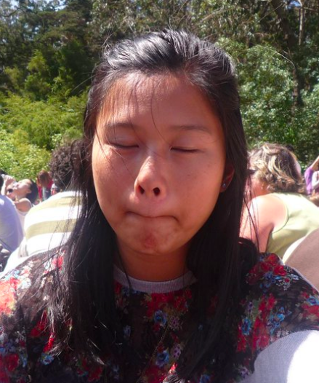
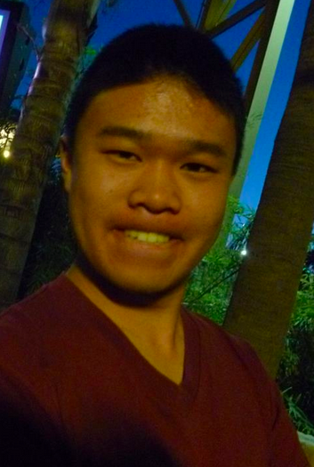
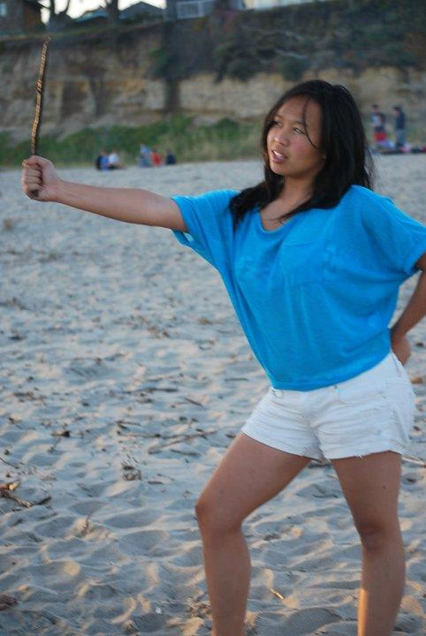
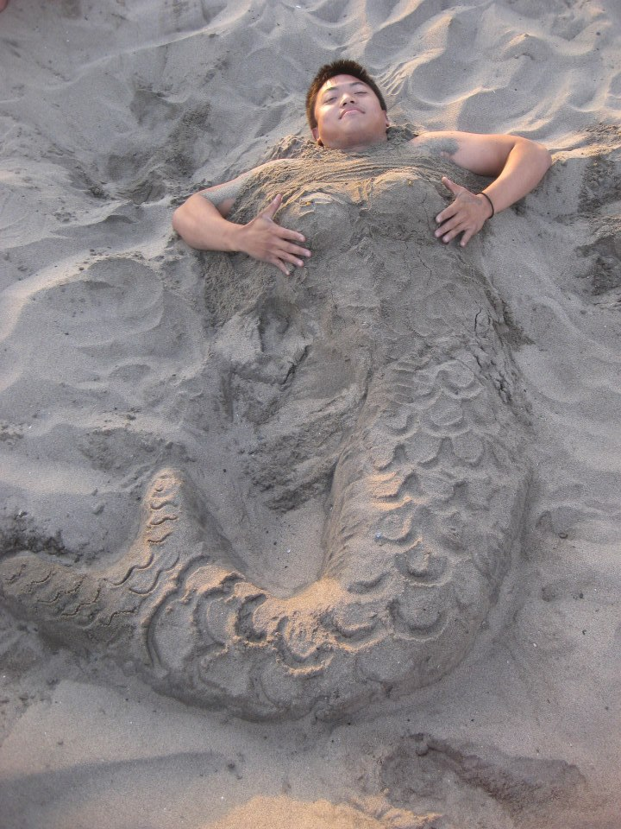
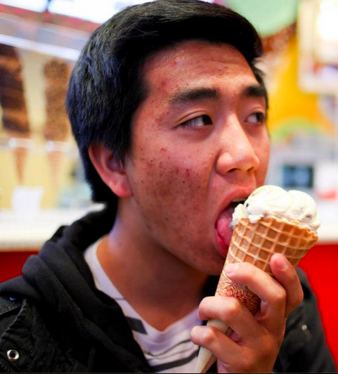
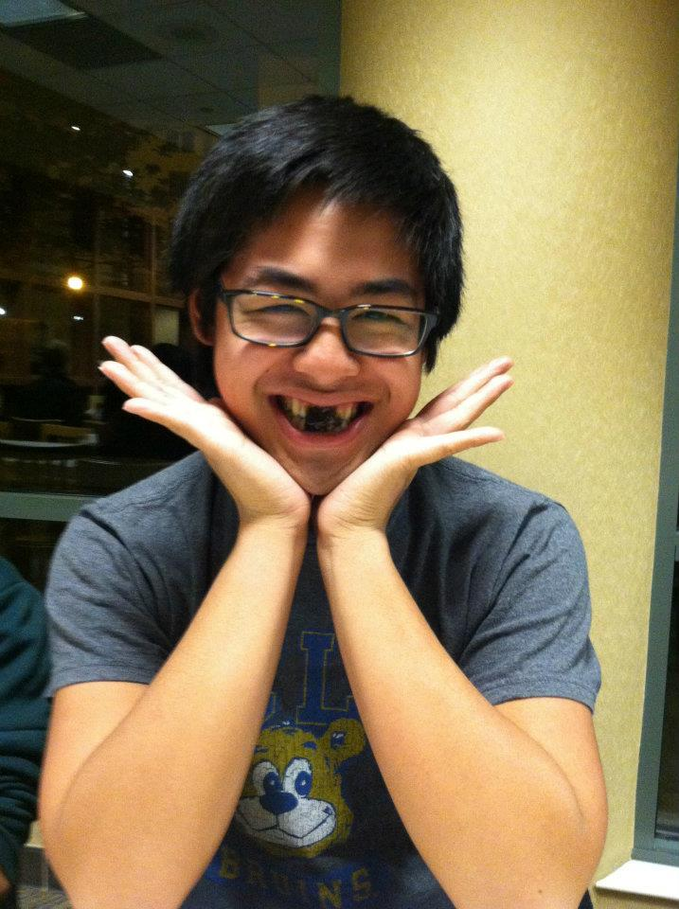
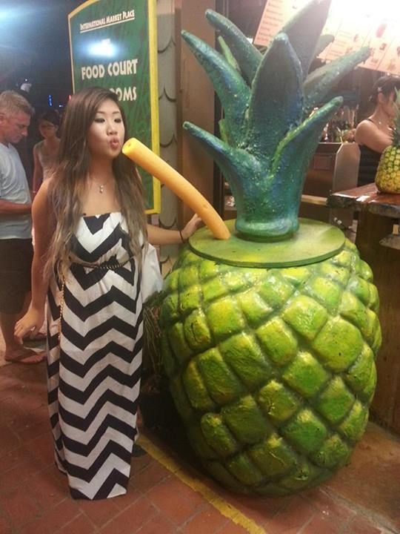
Brothers of Chi Chapter

Slide 19

Headshots
If your last names start from I-M…
please stay after toast song…
for your HEADSHOTS!

Slide 20
Headshots
Althea Alquitran
Melissa Barcelona
Talia Berson
Jessica Bobis
Ernesto Bautista
Joseph Chan
Stephanie Choy
Anna Do
Vickie Do
Merry Fu
Holly Fuong
Jeremy Gozzip
Rui Guo
Jessie Hsieh
Peter Huang
Kristine Huynh
Maiko Ibay
Hazel Jeon
Bo Bae Jeong
Xin Jin
Mega Kakitsubo
Linda Kang
Alex Kim
Joanne Kung
Jenny Lam
Lisa Lau
Christine Lee
Brian Lee
Ariel Lei
Juana Li
Jun Li
Michelle Li
San Li
Sherry Li
Brandon Liauw
Alice Lim
Tracy Lin
Jonthan Liu
Bowen Lu
Roxy Luo
Vicki Luong
Hamilton Luu
Hoang Duc Luu
Danny Ly
Melissa Ma
Raymond Mai
Brian Martin
Amanda Mattes
Sonny Misa

Slide 21

Chi Trivia
For pledges :
Historian, President, SAA
What does that spell?
Hint : Think Greek letters

Slide 22
Chi Trivia
For pledges :
Historian, President, SAA
What does that spell?
Alpha Phi Omega
Hint : Think Greek letters

Slide 23

Chi Trivia
For actives :
Name 5
Chi Chapter Advisors.

Slide 24
Chi Trivia
For actives :
Name 5
Chi Chapter Advisors.
Gordon Huang
Rich Jhong
Bryan Lam
Ngin Lam
Anna Lee
Frank Lee
Tiffany Lin
Melinda Ly
Herumi Baylon
Chan Chan
Maggie Chan
Cindy Chang
Christina Chen
Yuna Choi
Paul Choung
Hieu Do
Linda Ghov
Andrew Ma
Hande Tan
Nina Tang
Tenmi Tchou
Terry Tiu
Betty Tran
Oakley Trinh
Jeff Tsair
Helen Van
Jason Wang

Slide 25

Brother of the Week #1
This brother has injured her/his thumb over 5 times.

Slide 26
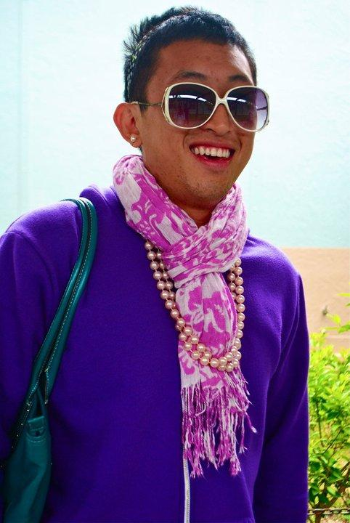
Brother of the Week #1
Danny Ly

Slide 27

Brother of the Week #2
Lil’ mack

Slide 28
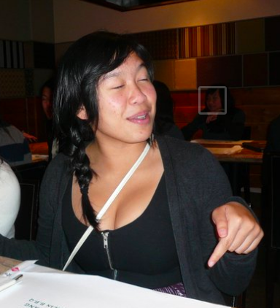
Brother of the Week #2
Dianne Pham

Slide 29
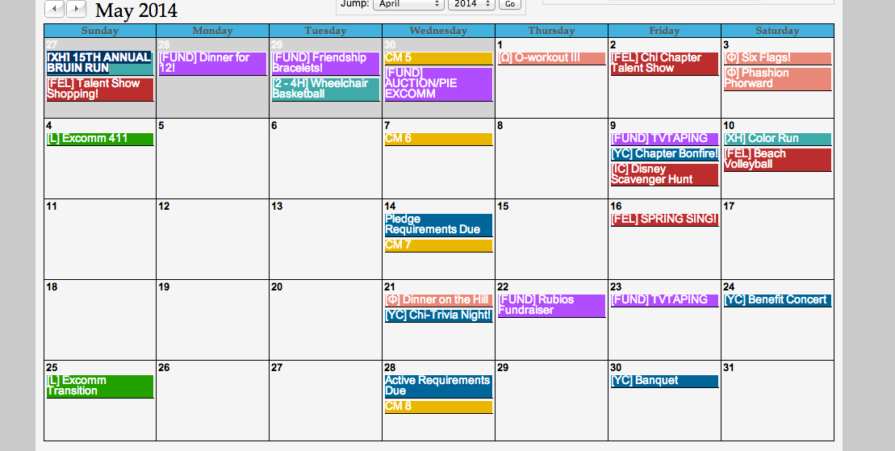
Chi Trivia Night

Slide 30
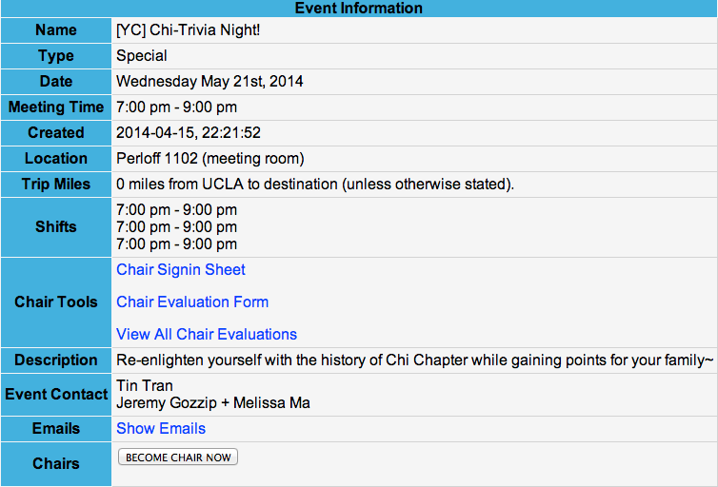
Chi Trivia Night

Slide 31
Interchapter Chair
Olivia Pardo
interchapter@apo-x.org

Slide 32

HELLO THERE ^__^
IC event after meeting!

Slide 33
Dance Comp
$5 donation
Please pay me by end of next week!
DANCERS
Fill out the waiver form!

Slide 34
Sergeant-at-Arms
Catherine Teotico
apoxsergeant@gmail.com

Slide 35
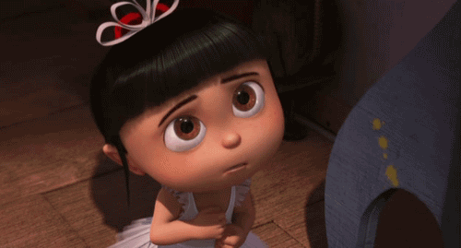
Please. . . .
Please, Please, Please Send All SAA Related Emails To:
Apoxsergeant@gmail.com
instead of my personal email (unless I signed up for an event)
THANK YOU!!!!

Slide 36
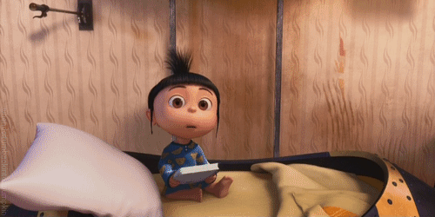
Now, The ABEA Goes To….

Slide 37
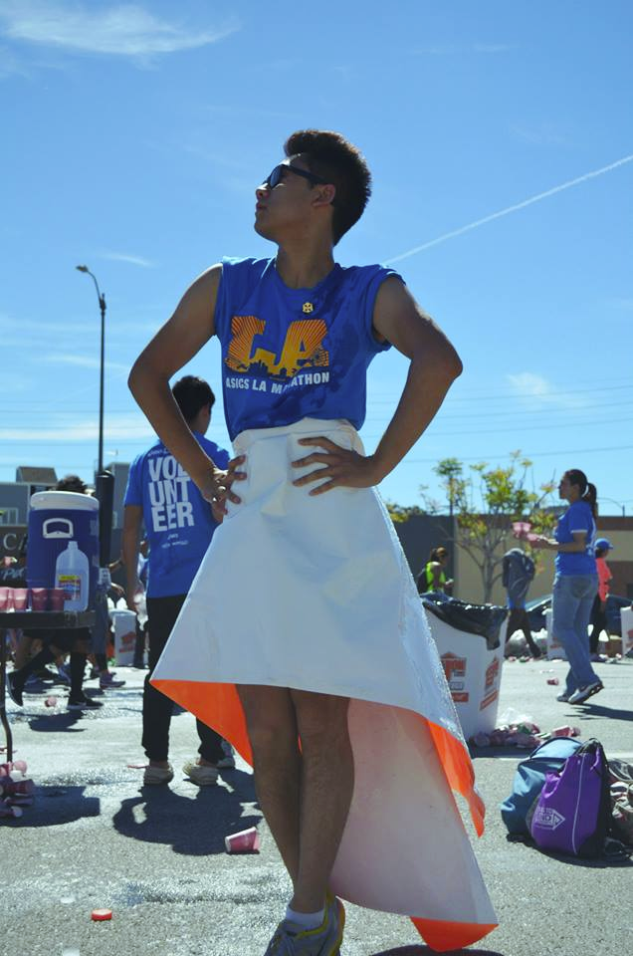

Nathan Cheung!
Dance Marathon was without doubt an unforgettable and life-changing event. We had to stand up for 26 hours straight (therefore literally "standing up" against pediatric AIDS), and it was definitely not an easy feat. I first thought that it was going to be very easy, but quickly realized how naive I was as we got around halfway into the event, when everyone's legs were shaking, veins darkened, on the verge of falling asleep. But quite frankly, in retrospect, I feel so accomplished, proud, and privileged to have been a part of such an amazing cause, because I (and I know the other actives) really believe in the cause we are fighting for (pediatric AIDS), as well as the main beneficiary (Elizabeth Glaser Pediatric AIDS Foundation).
Before the event, we had to do a lot of fundraising ($250 per person) in order to be able to dance for the full 26-hours. That in itself was a challenge already, but one we all luckily overcame after many rounds of calling, Facebook messaging, and contacting people. I made covers for those who donated for me!
After finishing our fundraising goals, we all got our costumes ready (because Dance Marathon has different themes every 3 hours just to freshen things up). When we showed up to the event, it was so nice to see all our team members dressed up head to toe in lime green (our team color), which just goes to show how passionate and enthusiastic we were. Of course, we all couldn't wait to start dancing (which, looking back, was definitely not the smartest decision since we lost all our energy really quickly!), and we were SO PUMPED!
Before we started, the hosts gave us an introductory talk and showed an INTRO video, which reminded us of the cause we were combatting against, and how we were helping that day. Over the course of the day, many educational videos were played (every 2 hours or so), which actually taught us a lot. We learnt that pediatric AIDS is 100% preventable, and that an AIDS free generation could be possible (by bringing mother-child transmission to zero), and I know that I learnt a lot that I would definitely teach my friends (I actually have already, and even taught my parents!), because I want to help combat this modern pandemic!
The dancing was so tiring (and it was mostly EDM), but every so often, there would be a performance by dance troops, a cappella groups, zumba instructions, and even team challenges to make sure we didn't fall asleep and to liven the atmosphere. All-in-all, I think that the organizers did a very good job of providing enough entertainment for us to not only stay awake for 26 hours (which is in itself already tough), but to stay standing (the hardest part!). Around every 5/6 hours, we also got a small meal, which was good for getting enough energy, because dancing was not easy!
Personally, however, I loved the dancing, and stayed on the dance floor for most of the times. Occasionally, people from our team would go up to the resting area to stand and take a rest, but we danced for quite a lot overall (good cardio). When the moralers came at around 1AM, we were so excited and so thankful, because they brought in so much energy that kept us going for another few hours!!
The toughest time was definitely at around 6AM-9AM, when we were all so sleepy and had a confused circadian rhythm, falling asleep whilst dancing. So many people were just lying on top of trash cans, railings, and boxes taking a short nap, but many remained on the dance floor. Luckily, we all pushed through, and manage to make it to 1PM, when we, alongside ALL the people in Pauley, collapsed on the floor, breathing a huge sigh of relief.
We found out immediately that Dance Marathon raised more than $440,000 this year, and I was so glad to see the fruits of our labor. Although I did initially feel like we did not contribute a lot, I was wrong. Because when the ambassadors (children affected by HIV/AIDS) talked to us, they really told me why we were dancing for 26 hours. I cried so much, for 15 minutes straight, because I was so inspired and touched, as I know all my brothers were too. I remember one of them telling us how "because [she] saw [us] pushing through and standing up, it made [her] want to push through even more, because taking medicine everyday is not easy"
, and another young boy who asked us "did you know that dance marathon is the best thing that has ever happened to me? I look forward to it every year.". Just simple, candid, brave statements like that reassured every effort I gave to fundraise, stand up, and dance for the event. I was touched deep down, and so happy that we helped in some way, as I am sure all my brothers were.
Overall, we definitely loved the event, and there weren't weaknesses really. We learnt so much, and it really inspired us to continue helping pediatric AIDS and those affected by this malicious disease. The only thing I would say is that next year, perhaps more advertising could be done beforehand to get MORE PEOPLE involved, because it really is an amazing, and eye-opening experience.

Slide 38
ABEA WINNERS COME SEE ME TO GET YOUR CANDY
Bryan Park
Andrew Suh
Joseph Chan
Nathan Cheung

Slide 39
Finance VPs
Emily Neai-Proeung & Jonathan Liu
finance@apo-x.org

Slide 40


DUES $$$$$$$$$$
Actives & pledges on payment plan: $20
Everybody should be finished paying by today!
Pay Finance VPs, Peter Huang or Cindy Nguyen!

Slide 41
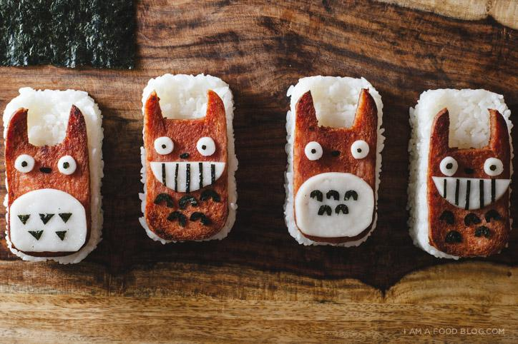
Spam Musubi Delivery!
Next Wednesday, April 23rd
Facebook event will be created soon
Taking online orders & delivering to apartments/dorm rooms
SIGN UP!

Slide 42

TVTAPINGS!
Sign up for next weeks!
4/23 Cuz-Bros! ~$25
4/25 SEE DAD RUN- Needs drivers!

Slide 43
Fundraising updates
Past 2 TV tapings: $16 per person
Bake sale: $88 profit!
Fruit cup sale today: Sold out!
Lots of events on the calendar - remember to sign up!
Closer towards reaching our goal for
AUTISM SPEAKS :)

Slide 44
Fellowship VPs
Michael Hung & Dianne Pham
fellowship@apo-x.org

Slide 45
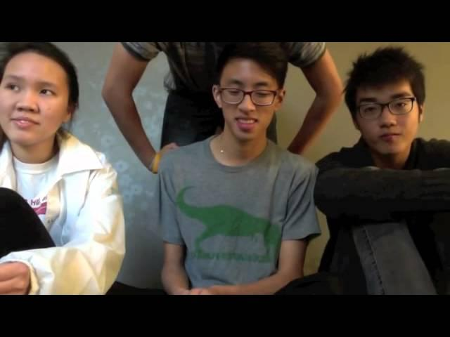
Flog#2

Slide 46
Service VPs
William Nguyen & Jade Vo
apoxservice@gmail.com

Slide 47

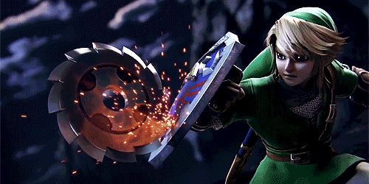
Tracking!
All hours should be updated as of Tuesday, April 15! Please let us know if there are any inconsistencies!

Slide 48
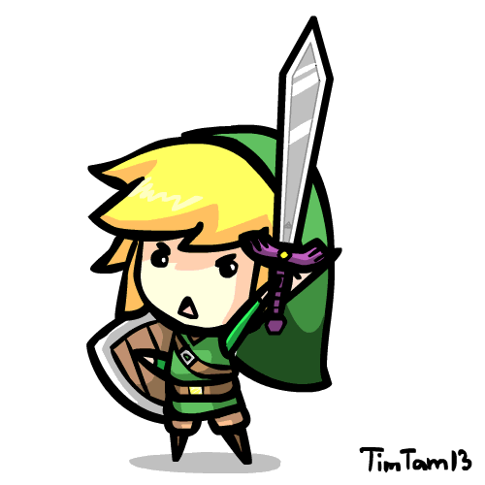
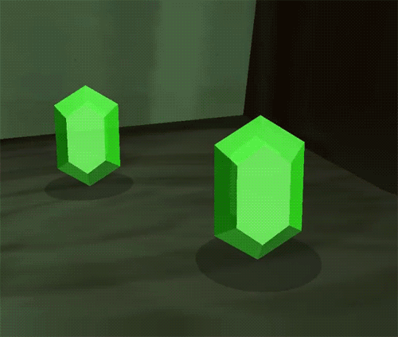
Event Highlight: Host a Student!
This weekend only! Sign up to host a student! Get 3 hours of service easy! Do service to the campus by helping prospective students decide on SIRing or not!

Slide 49
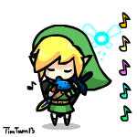
Bruin Day!
Sign Ups are closed…
If you’re not signed up through the UCLA google doc AND you are signed up on the APO website, you must remove yourself (or else you will be striked for flaking)

Slide 50
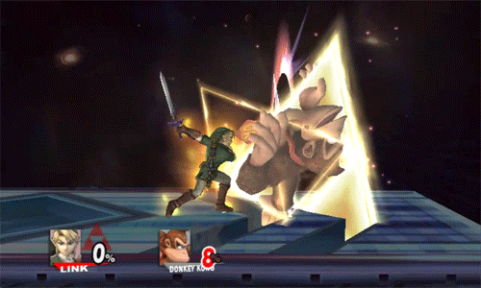

Benefit Concert Updates!
Schedule of Events!
Flyer design nearly complete!
We should have these ready by next week or so!
Look out for flyering shifts! (Worth 1 service hour each!)
THANKS PAUL FOR LETTING US USE YOUR EQUIPMENT!

Slide 51


***tentative

Slide 52
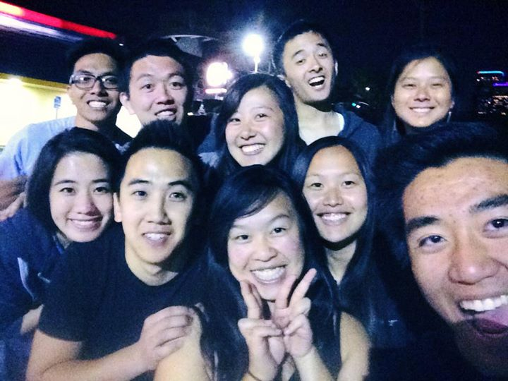
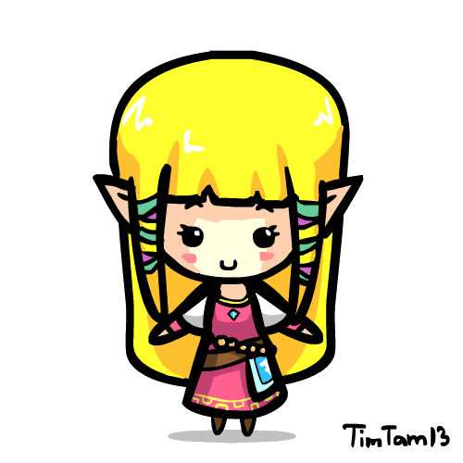
SBotW!
The SBotW is in this pic!

Slide 53
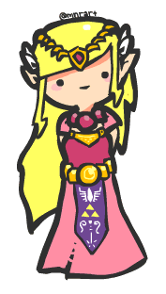
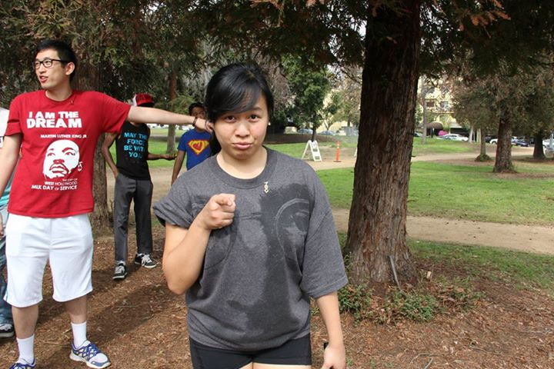
SBotW
DIANNE PHAM!

Slide 54

SBotW!
The next brother of the week stood for 26 hours in support of pediatric HIV/AIDS!

Slide 55
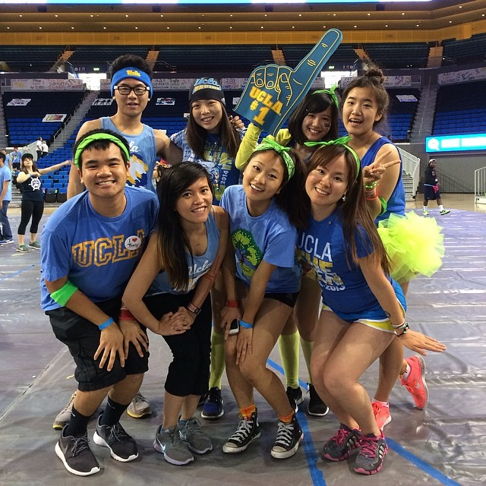

SBotW
DANCE MARATHON DANCERS!

Slide 56
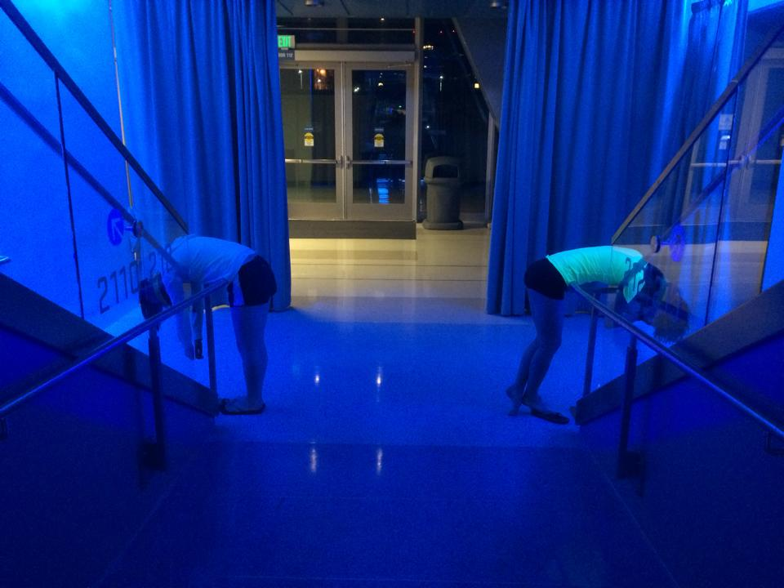
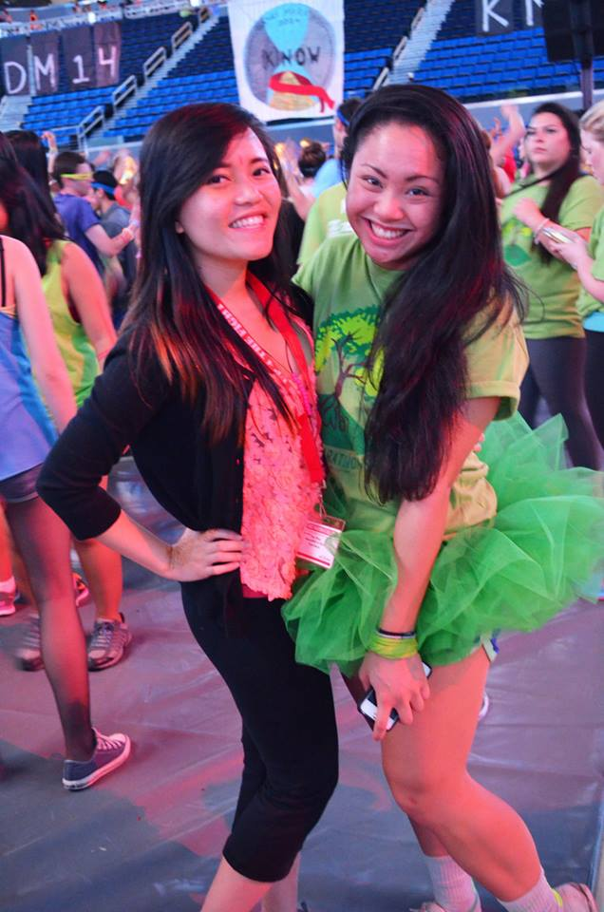
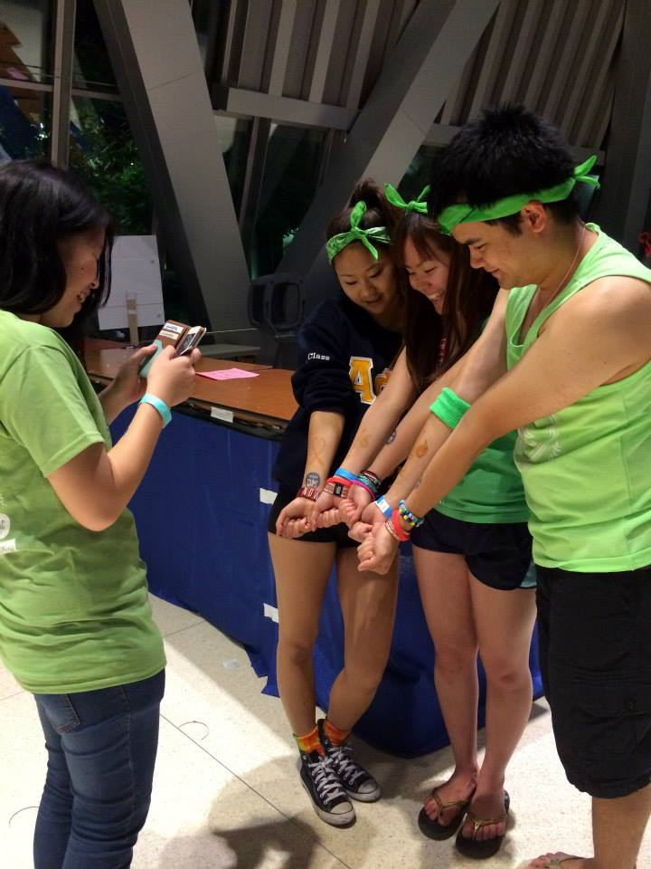
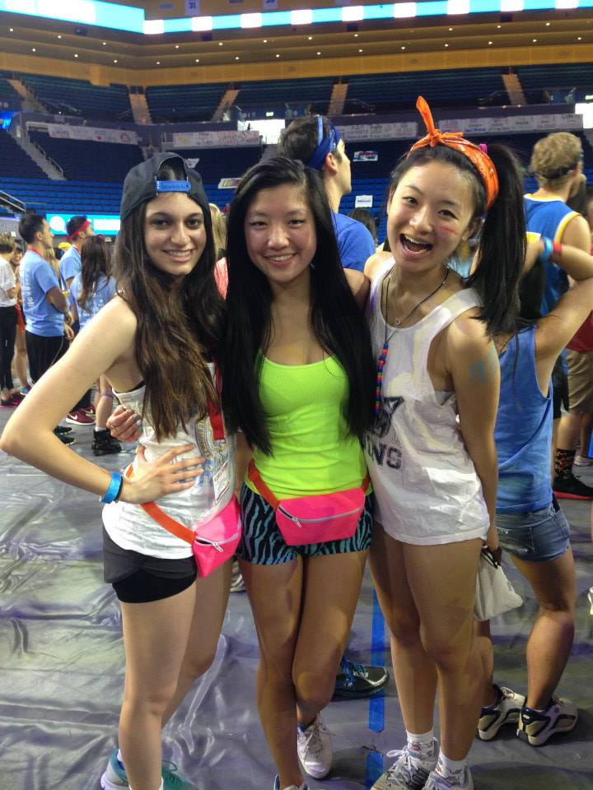
Dance Marathon!
All dancers receive 26 hours of service!
All morallers receive 4 hours!

Slide 57
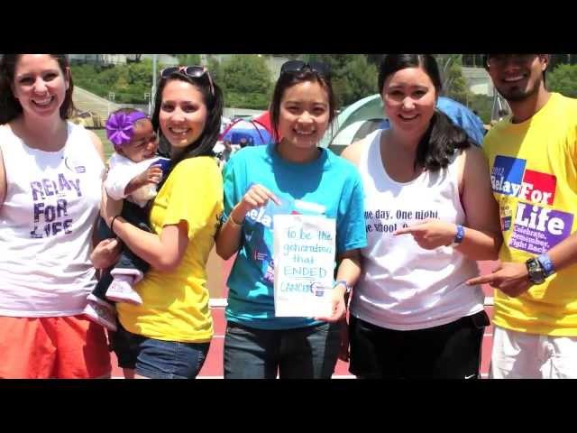
Education Time! Relay for Life!
WHAT?
WHERE: Drake!
WHEN: 24 HOURS! APR 26 - 27!
WHY?
JOIN JOIN JOIN JOIN!

Slide 58
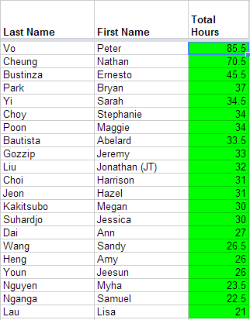
SERVICE HOURS UPDATE
THANKS FOR BEING DONE WITH SERVICE GUISE! YOU ROCK!
If you have concerns with service, feel free to contact us directly!

Slide 59
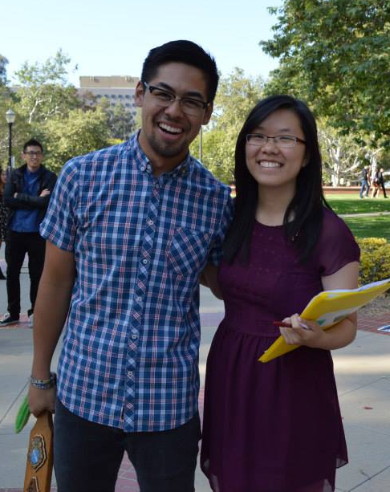
Membership VP
Jeremy Gozzip & Melissa Ma
membership@apo-x.org

Slide 60
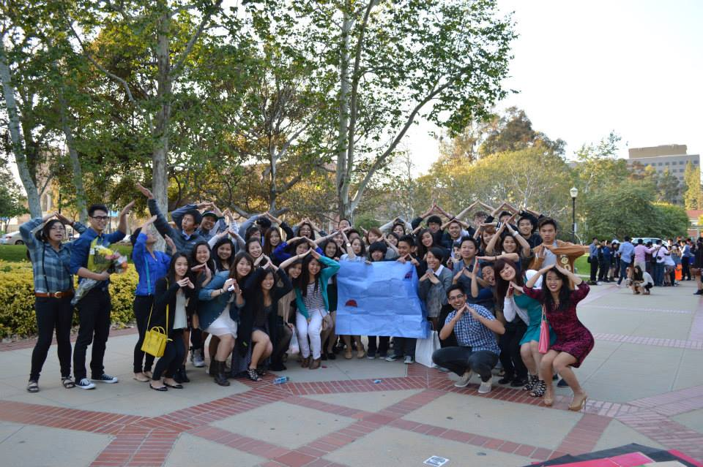
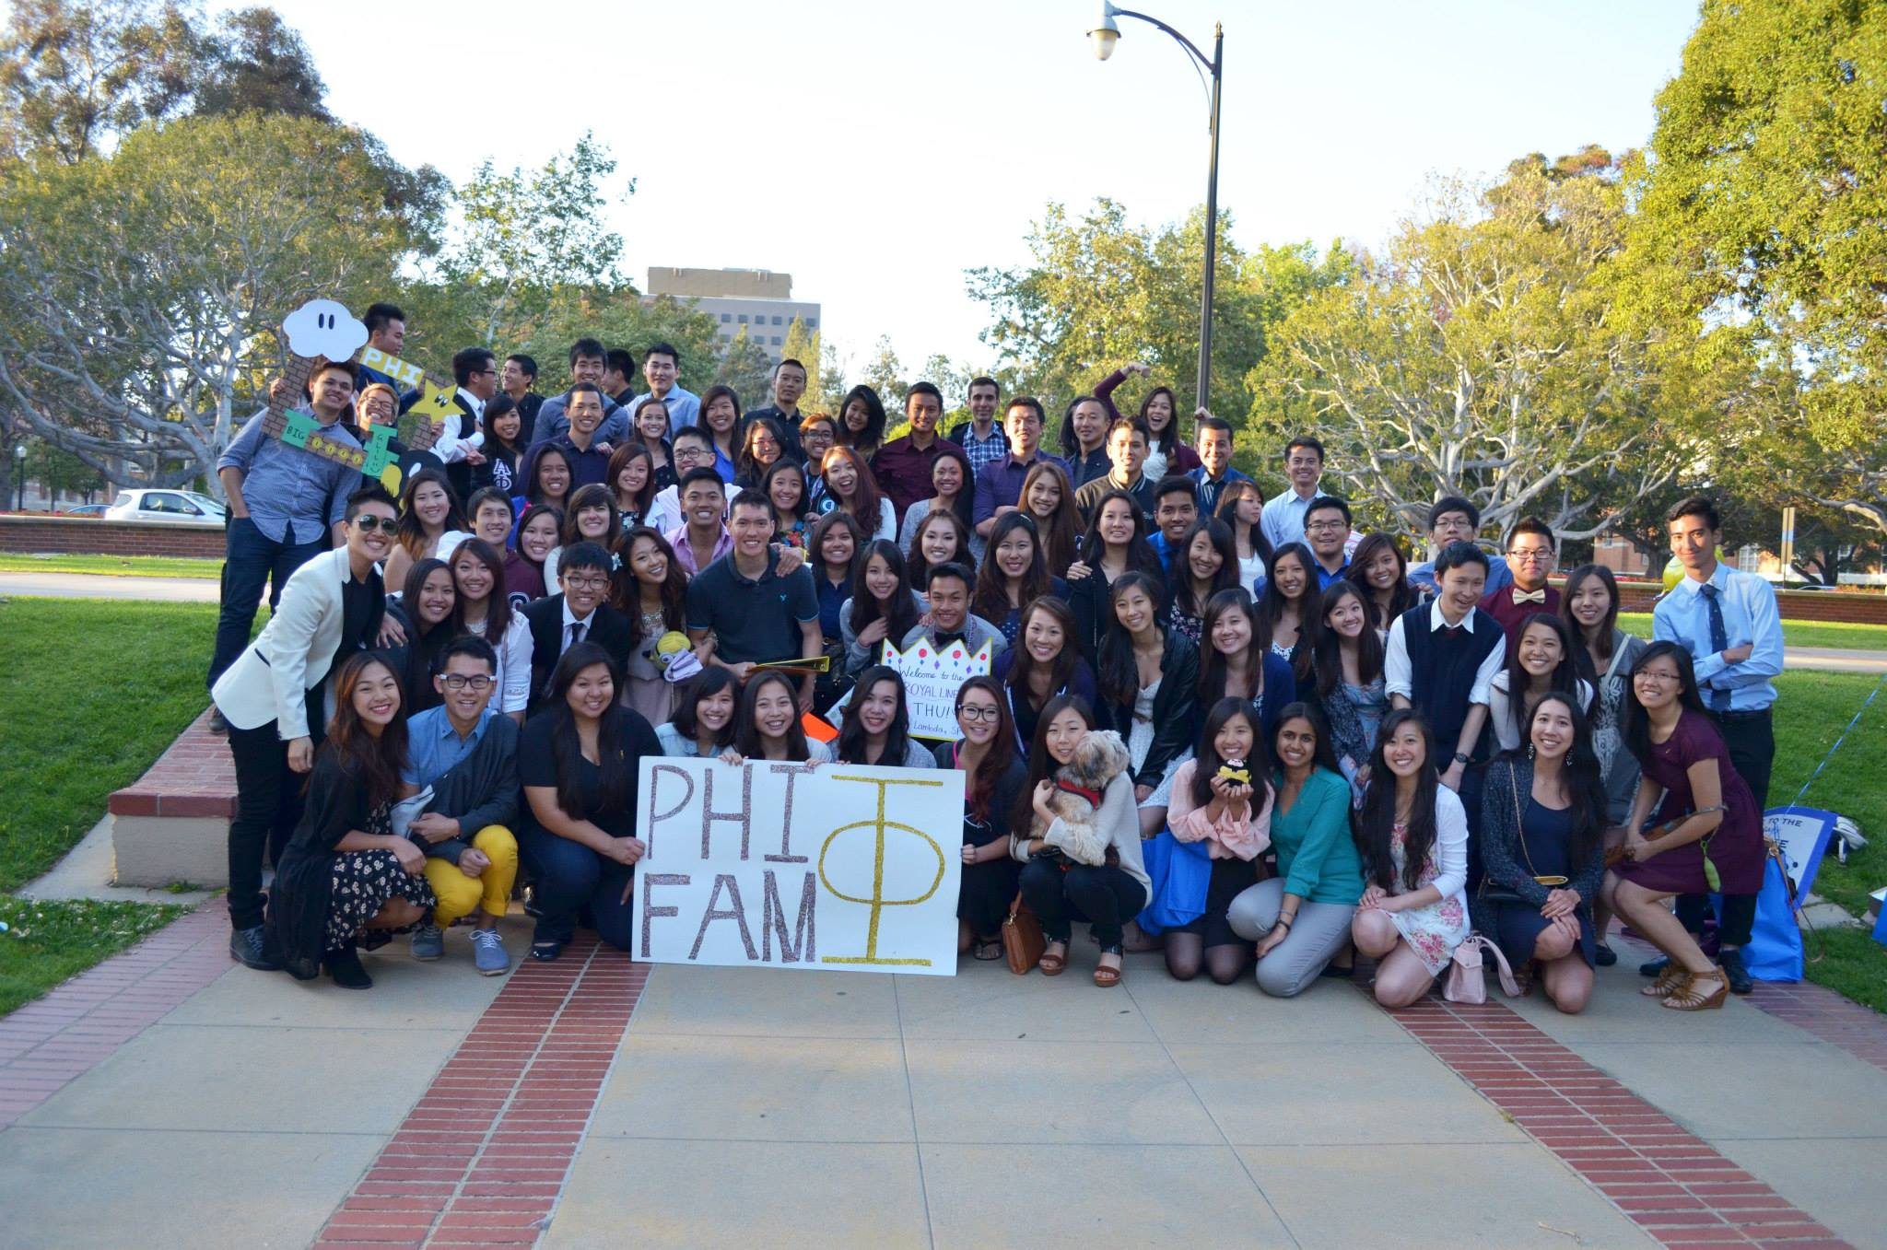
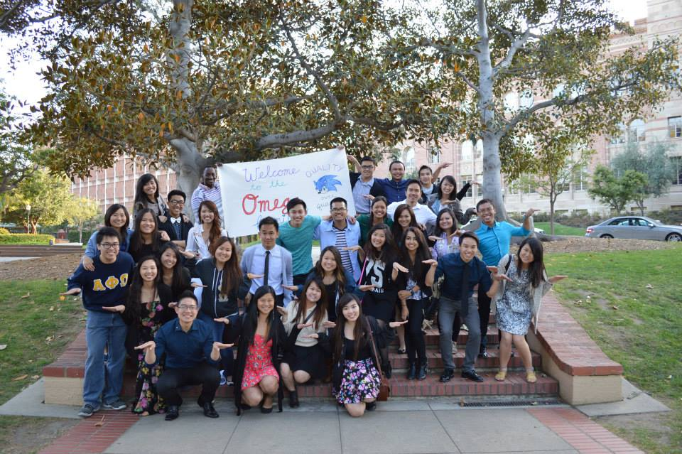
Welcome New Family Members!
Don’t forget to sign up for family events on the calendar!

Slide 61
Revelations
THANK YOU
to our hardworking and dedicated
FAMILY HEADS and SPIRIT COMMITTEE.
Thank you to everyone for coming out and being so enthusiastic and cooperating!

Slide 62
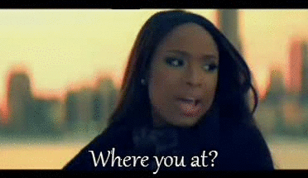
Family Shirts!
Where dey at?
If you be wearing yo family shirt, stand up and show some pride!

Slide 63



Family Shirts!
We have them for actives :]
They are only $5, and you can get your own at the end of meeting! :D
Just see FamHeads.

Slide 64
Upcoming Chapter Events
4/23 Family Brawl
5/9 Chapter Bonfire
5/21 Chi-Trivia Night
5/24 Benefit Concert
SIGN UP!

Slide 65
Shoutout Book
“I would like to make a shout-out to Rachel Belyea, Maiko Ibay, and Jade Vo based on the Bake Sale Service.
Rachel: Thanks for getting the baking stuff and sending out the email even when you weren’t going to attend the event!
Maiko and Jade: Thanks for not only doing a lot during the bake sale service itself, but also being willing to stay almost and HOUR after everyone had already left to wait for the brownies to cool and pack them up with me. I know you both were super hungry.”
-Michael Hung

Slide 66

Achievement # 3
LEVEL 3: Take a picture of 3 person human pyramid representing the triforce symbol.
3 family minimum (aka one person from each family)
Each person has to wear their family colors (Alpha=Red, Phi=Green, Omega=Blue)

Slide 67

Active Mission # 1
Group assignments are done!
We will e-mail out further instructions shortly.

Slide 68
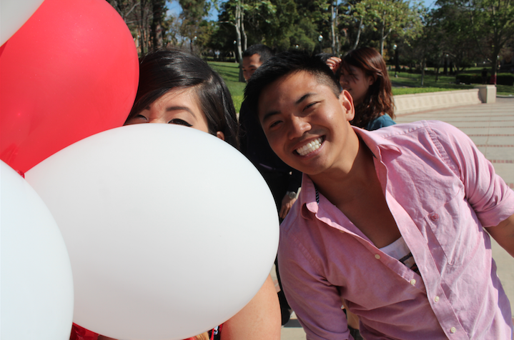
Pledge Parents
Sean Tran & Annie Tran
pledgeparents@apo-x.org

Slide 69
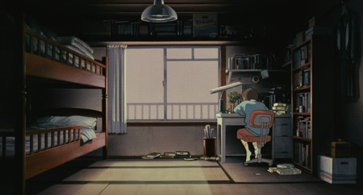
Quizzes
Greek Alphabet
Region director, Section 1&2 Chairs, & colleges in each section

Slide 70

Pledgucation & Mission
Chi chapter Jeopardy - winning team got .5 strike off
Mission this week - Music Videos!

Slide 71

Camp out & Revelations!
Camp out!
You guys are all amazing!
Revelations
Big/ little pairings
Take care of our babies <3

Slide 72

Doodle - Active Sign Ups
If you have not already, please sign up on the google doc if you wish to be a REQUIRED interview

Slide 73
Administrative VPs
Joseph Chan & Nicola Yip
admin@apo-x.org

Slide 74
Updates
WiChipedia will be back up by next week and we will be adding information throughout the term

Slide 75
Chair of the
Advisory Committee
Kevin Lee
cac@apo-x.org

Slide 76
Last Announcements

